Slide 1
UIDAI-Aadhaar Hackathon 2021
TEAM NAME : No0bH@ckers
REFERENCE ID : jbtUQB0mkM

Slide 2
TEAM DETAILS
TEAM NAME – No0bH@ckers
REFERENCE CODE – jbtUQB0mkM
GITHUB URL -https://github.com/mihirgadwalkar/UIDAIHackathon2021TeamNoobHackers
MIHIR GADWALKAR – mihirgadwalkar@gmail.com – 8500949312 – 8919765283 (TEAM LEAD)
SHASHANK APPANA – shashankappana@gmail.com – 9642463910
G.V KEERTHANA - 9182974873
P. SAHANYA - 8106383848
B. PRAVARDHAN - 9000381380

Slide 3
PROBLEM STATEMENT-3 : ADDRESS FORMATTING ISSUE
UIDAI Address Object Consists of Common Fields Like
House/Building/Apartment
Street/Road/Lane Area/Locality/Sector, Landmark,
Village/Town/City
Pin-code
Sub District
District, State

Slide 4
Often Address in Urban Area Contains Repetition of Texts
Example : “Mumbai”
De-Clutter the Address
Identify Repetitive Constituents
Merge and Format the Address
Optionally Solve for Local Language Address
Develop the API which will undertake Address Formatting
Accepts the Address in Raw Form (English and Local Language Address)
Formats the Address and Presents as an Output
Must be a Scalable Design

Slide 5
SOLUTION
We have designed an API we solves the problem of address formatting, it accepts input in the form of JSON and also outputs the same in form of JSON.
For Simplicity to understand we have put the working in form of a web application developed using MEAN Stack.
It takes input as Aadhaar Number and checks if it’s a registered user otherwise it ask’s the user to register for AADHAAR.
It outputs the formatted address in form of a JSON which is displayed upon clicking Update Address.
It also consists a Register Address option which accepts Aadhaar Number and other Address fields among which few can be optional as inputs and stores the same in the database.
We have tested enough inputs and it worked for all.

Slide 6
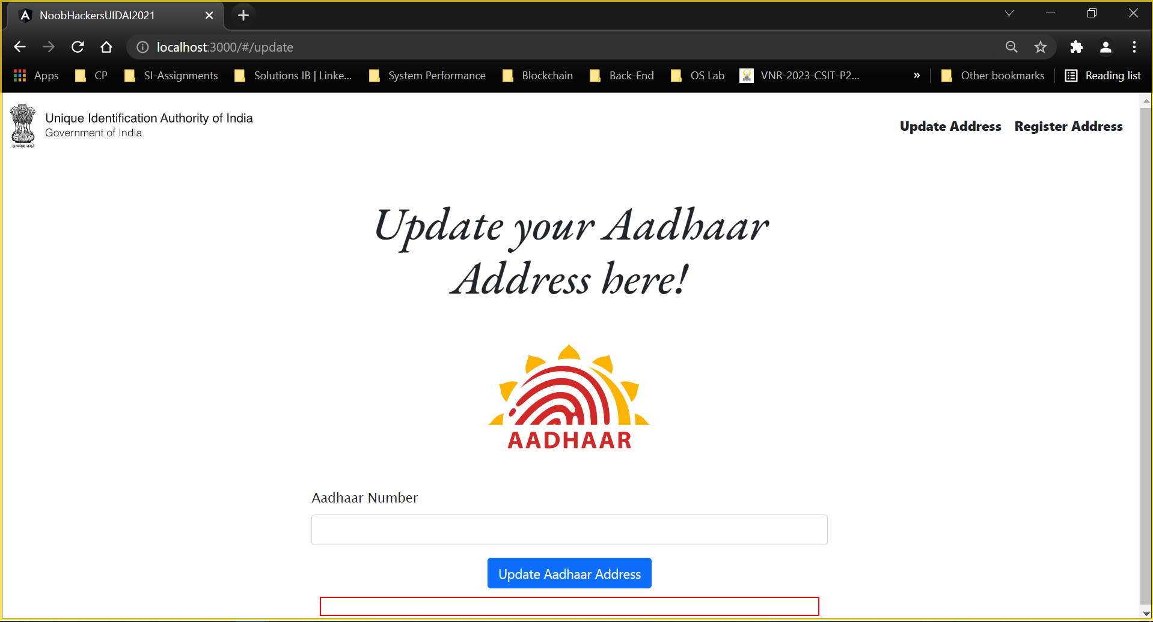
SCREEN SHOTS

Slide 7
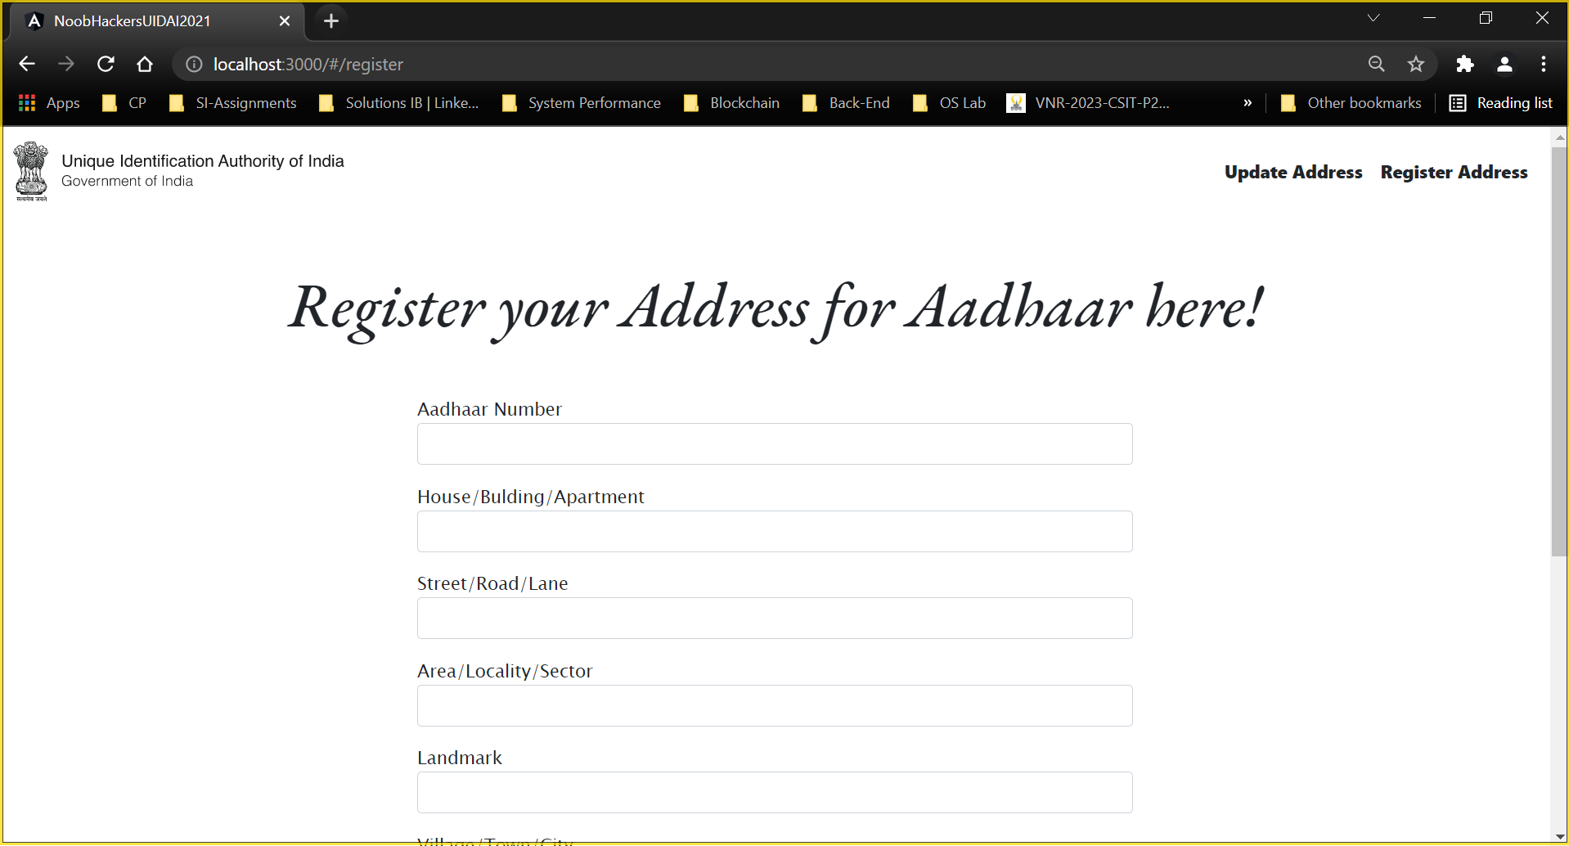
SCREEN SHOTS

Slide 8
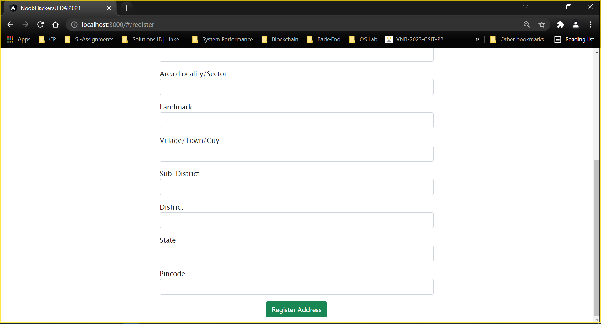
SCREEN SHOTS

Slide 9
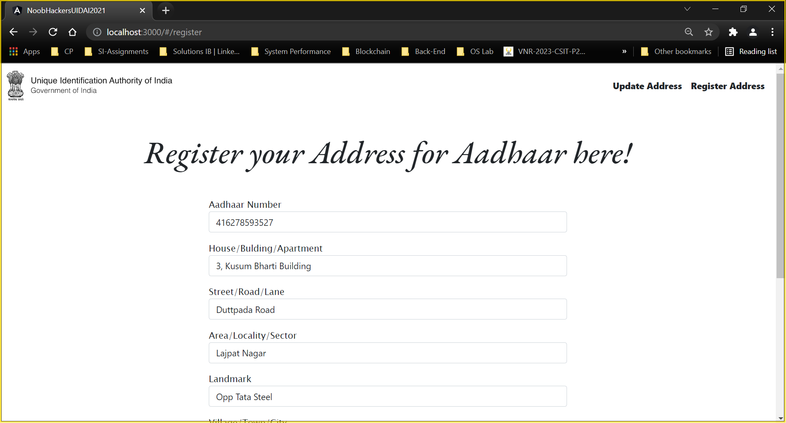
SCREEN SHOTS

Slide 10
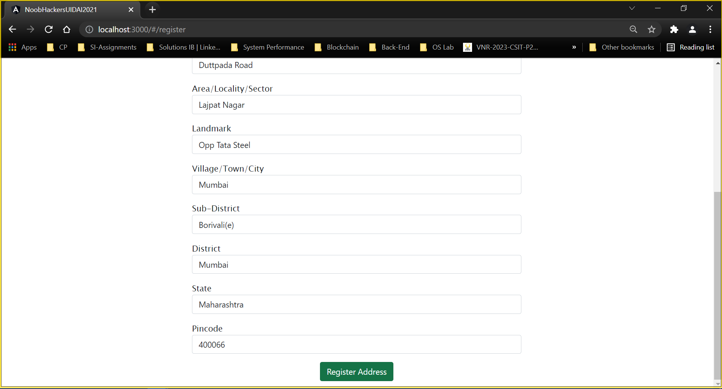
SCREEN SHOTS

Slide 11
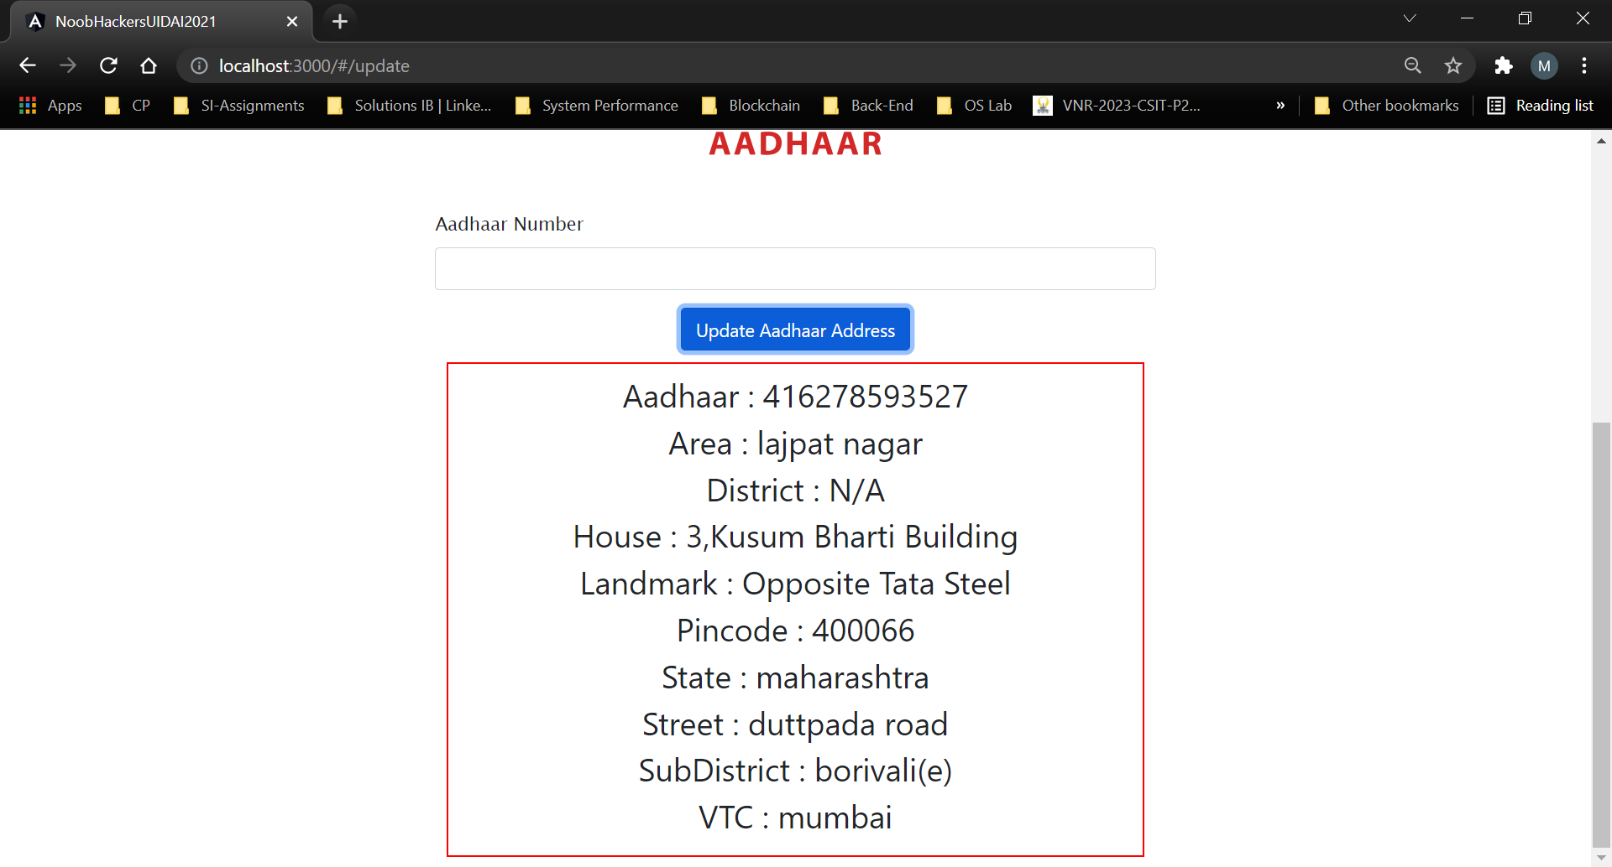
SCREEN SHOTS

Slide 12
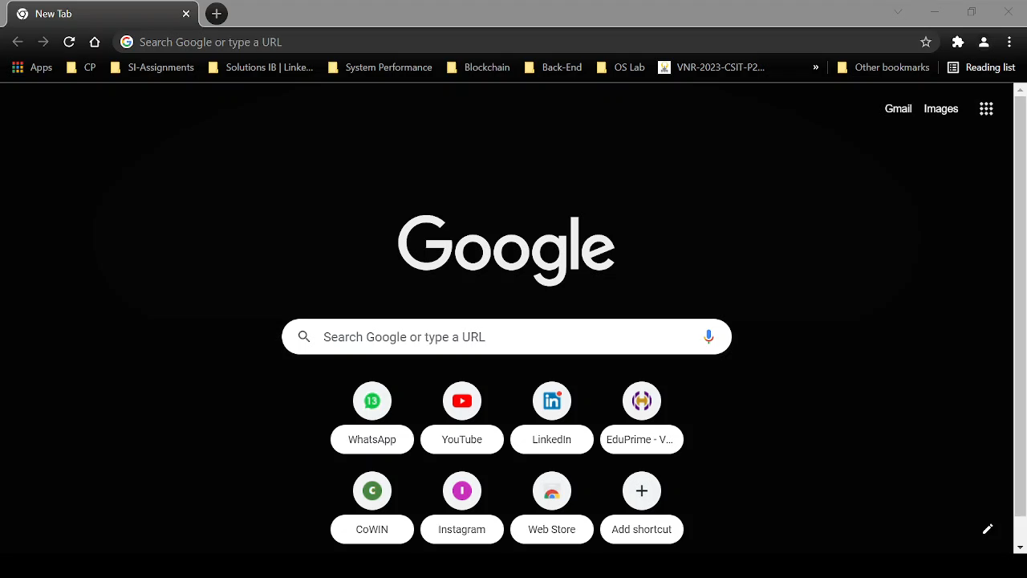
DEMO VIDEO

Slide 13
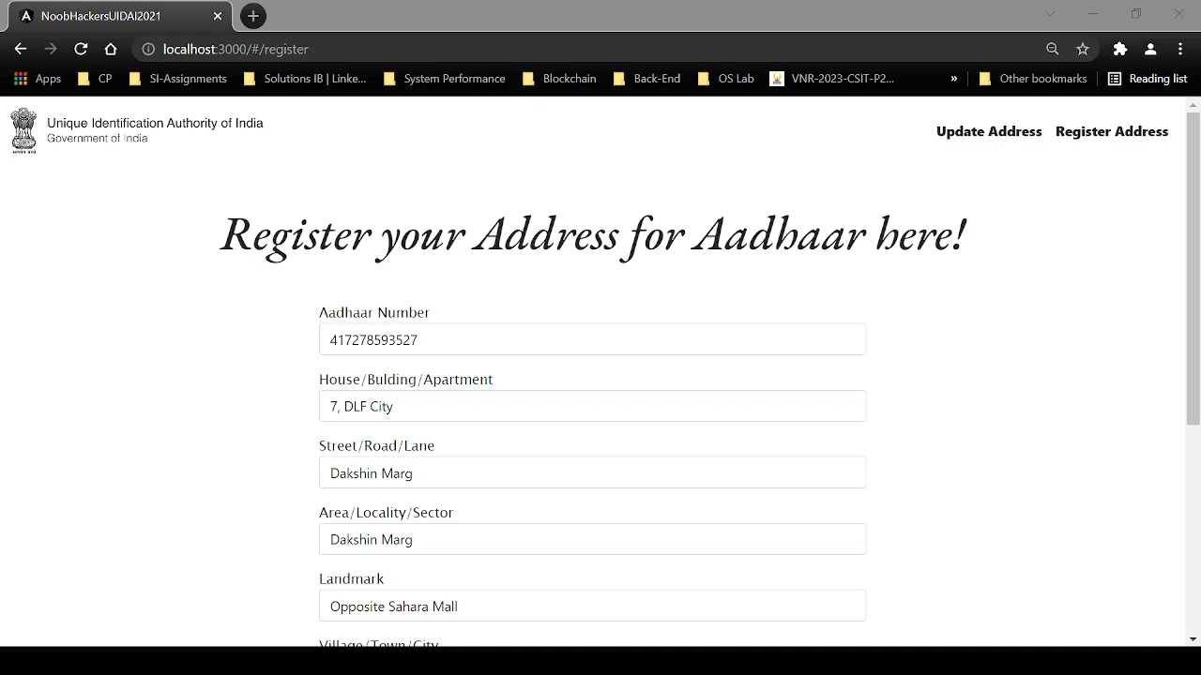
DEMO VIDEO

Slide 14
LINKS
DEMO VIDEO LINKS
https://drive.google.com/drive/folders/1sSvAf_cinjABPCQ-FPakuRHCyLXL6QKF?usp=sharing
SOURCE CODE GITHUB LINK
https://github.com/mihirgadwalkar/UIDAIHackathon2021TeamNoobHackers

